Slide 1
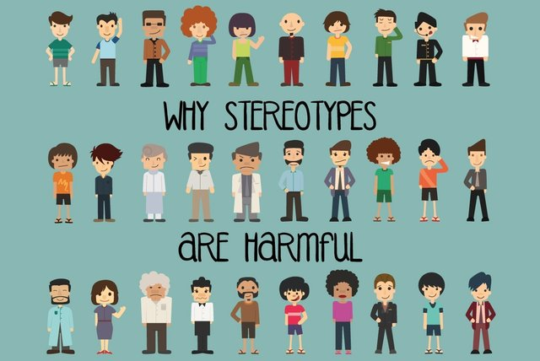
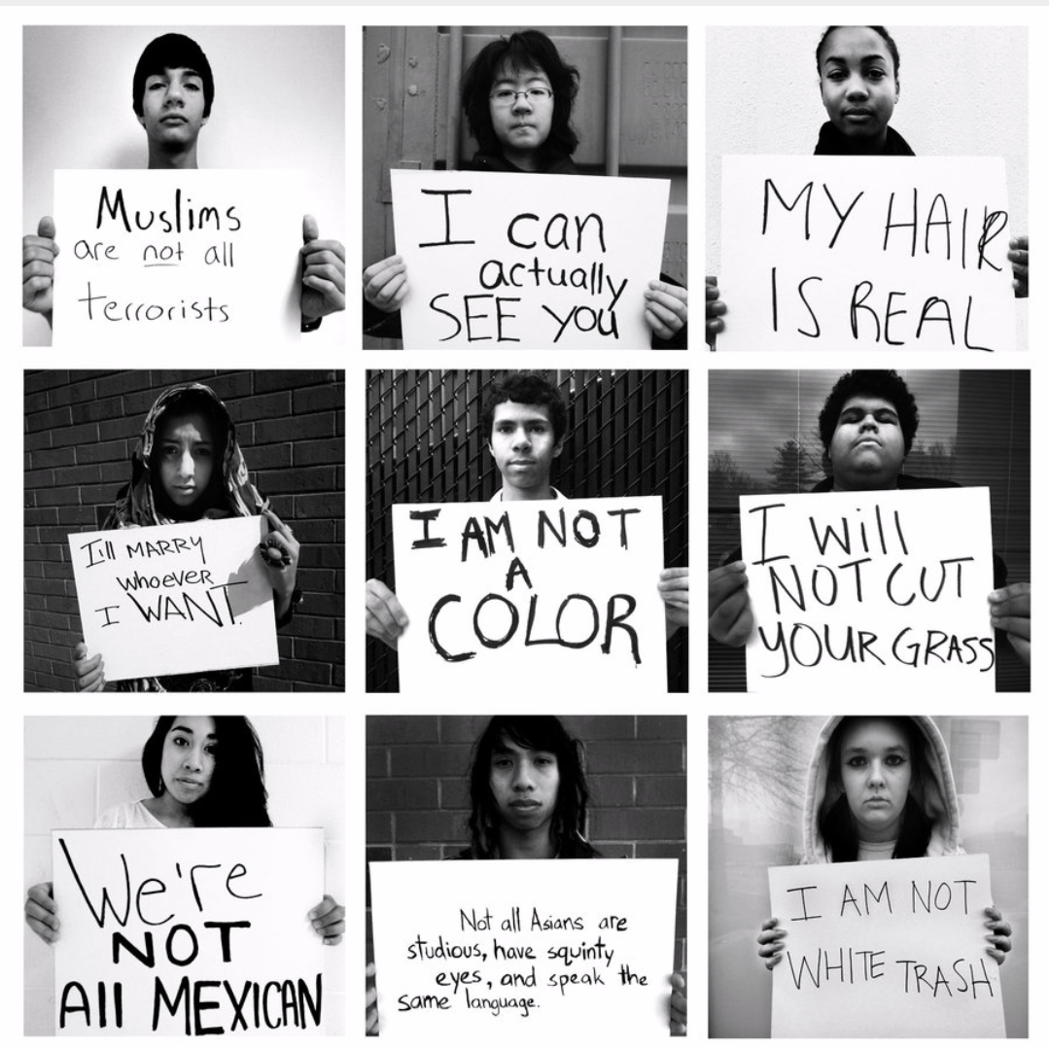
Stereotyping activity
World history honors

Slide 2
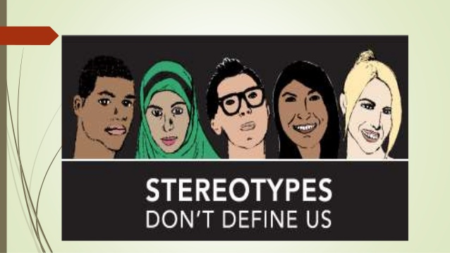
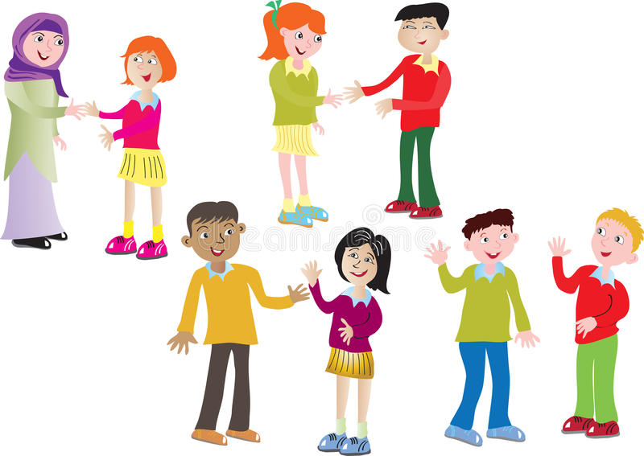
Categorizing & assumptions
People often use labels and categories to describe others
Labels can be based on characteristics such as:
Looks:
Skin color
Clothing style
Weight
Hair
The Way a person talks
Groups he or she belongs to
Presumed country or state of origin
Religion
Gender Identity
And much more

Slide 3
Categorizing & assumptions
Categorizing things or people is a natural human inclination
However, people often make assumptions about groups of people they don’t even know
Sometimes it’s based on things they hear
This can lead to unfair judgements that affect people’s lives
Our stereotyping activities will illustrate misconceptions that people might have. You will also see how you might be different and be surprised about how many things you might have in common.

Slide 4
Stereotyping activity directions
10 boards, 10 groups (3 students per group)
Each board has a category and your group will write two (2) stereotypes about that category onto post-it notes --- attach them to the board
Your group will rotate clockwise (to your right) around the room to the next board and will write one (1) stereotype about that category onto a post-it note --- attach it to the board.
Continue rotating to each category, adding one (1) stereotype to each board until you have reached every category.
Eventually your group will end up at your original board.
We will then discuss together as a class.
Rules:
No profanity
Do not repeat items on the board

Slide 5
THE TIP OF THE ICEBERG. You may have heard the statistic that approximately 90 percent of an iceberg is found under water.
People are like icebergs. You think you know that person or category, or you think you know how all blondes are, or all old people, Jewish people, Muslim people, Christians, Latinos, athletes, cheerleaders, teenagers, Asians, Mexicans, Venezuelans, Native Americans, African Americans, Caucasian – you might judge them based on your assumptions.
But you really don’t know them only by what you can see. So much is below the surface, hidden from view and yet so very instrumental to who that person is and how he or she interacts with the world.

Slide 6
Stereotyping activity debriefing
Were any stereotypes posted about groups or categories that you belong to? How did it feel to see them “in print”?
Where do these stereotypes come from? How are they perpetuated?
Were positive as well as negative stereotypes posted? Why should positive stereotype be avoided?
Suppose your best friend believes that all the stereotypes about a certain group are true. How would you deal with that situation?
Do most people hold the same assumptions about a group? Why or why not?
Do people’s assumptions apply to everyone in a group?
Do assumptions tell us anything definite about a categorized individual?
How do assumptions affect your behavior toward others?
What are some things we can do to avoid perpetuating stereotypes?
What if there were no stereotypes? Do you think people would behave differently?

Slide 7
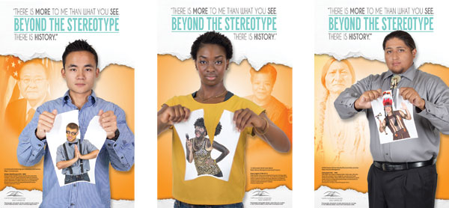
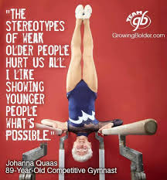
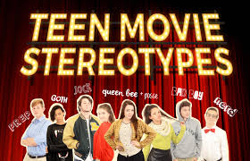
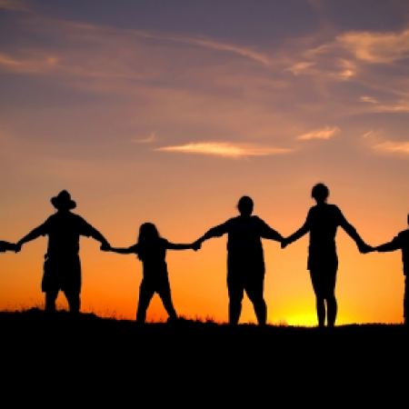
People would understand each other better, judge each other far less, and have more compassion for each other if we could simply take a walk in one another’s shoes — that is, see the world entirely as someone else sees it, if only for the shortest period-of-time.
I think we’d all be amazed at what we would learn about ourselves, each other, and reality in general.
OVERCOME Break the teen stereotypes!

Slide 8
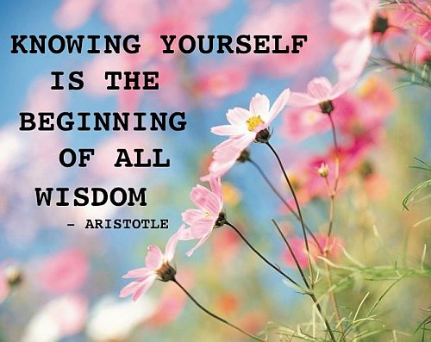
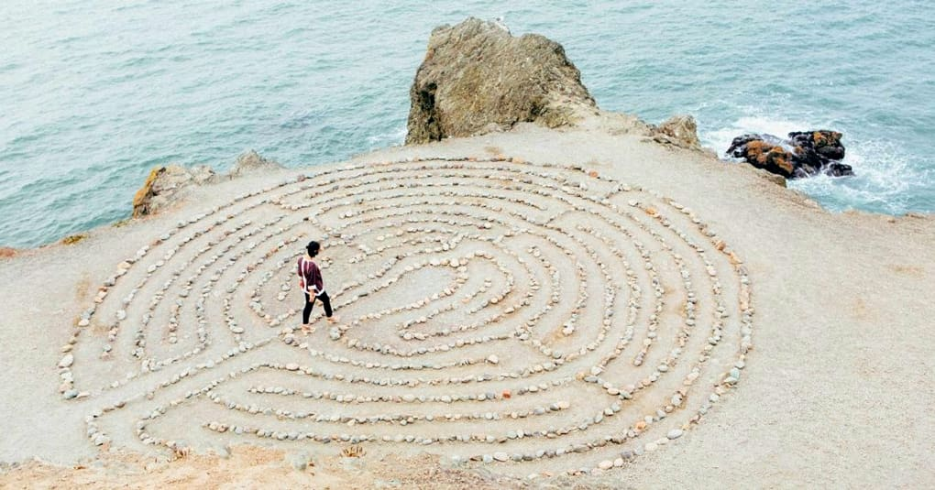
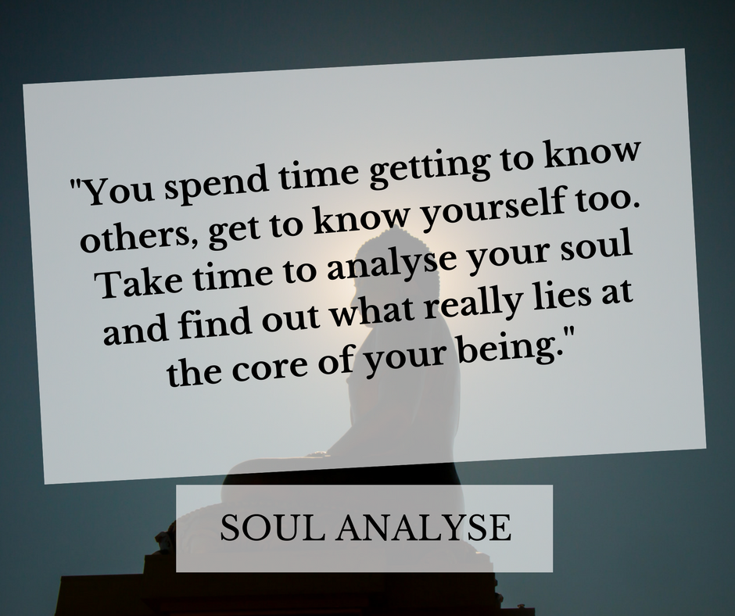
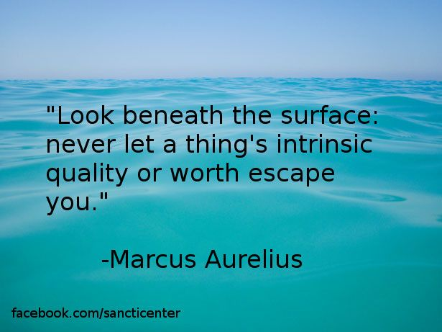
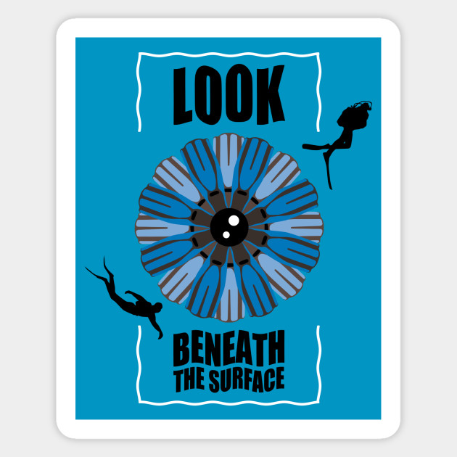
How about you? Are there parts of you that you’ve always kept hidden from view — and maybe you always will?
The best way to understand ourselves - and each other — is to be willing to peer below the surface. Get to know someone. Explore, and be open to new possibilities and perspectives.
Look Beneath The Surface and See What Beautiful Things You Will Find!

